Slide 1
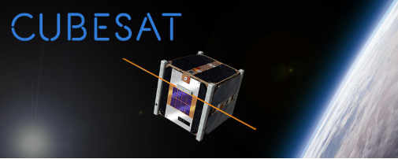
An Alternate Approach for CubeSats: The TubeSat
Shawn Nase, Jimmy Oakes, Zach Cullen, Mark Bright
Electrical Engineering Department
Penn State University

Slide 2


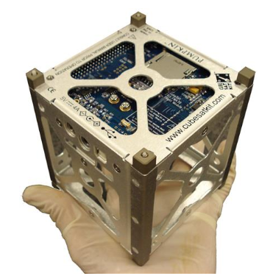
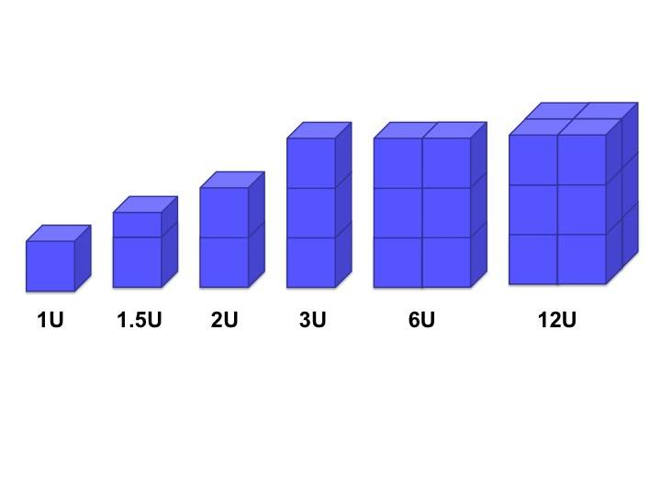

What is a CubeSat?
Small-scale, low cost satellite
Often used in academia and independent research
Directly expose electronics to environmental effects of space
Generally use space rated electronics
12U: 208mm x 208mm x 340.5mm

Slide 3
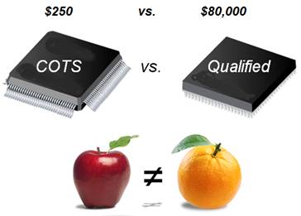
Our Approach
Key feature of design is an airtight container
Allows use of commercial off the shelf (COTS) electronics
Shield electronics from environmental effects
Tailor design to short-term ‘suicide missions’
Test under simulated space conditions
Goals: $1500, open source, continuously operate clock to blink LED under simulated conditions of space

Slide 4
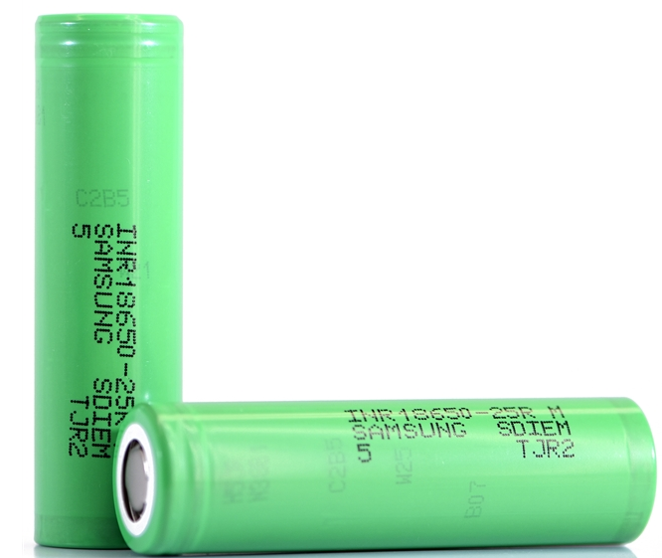
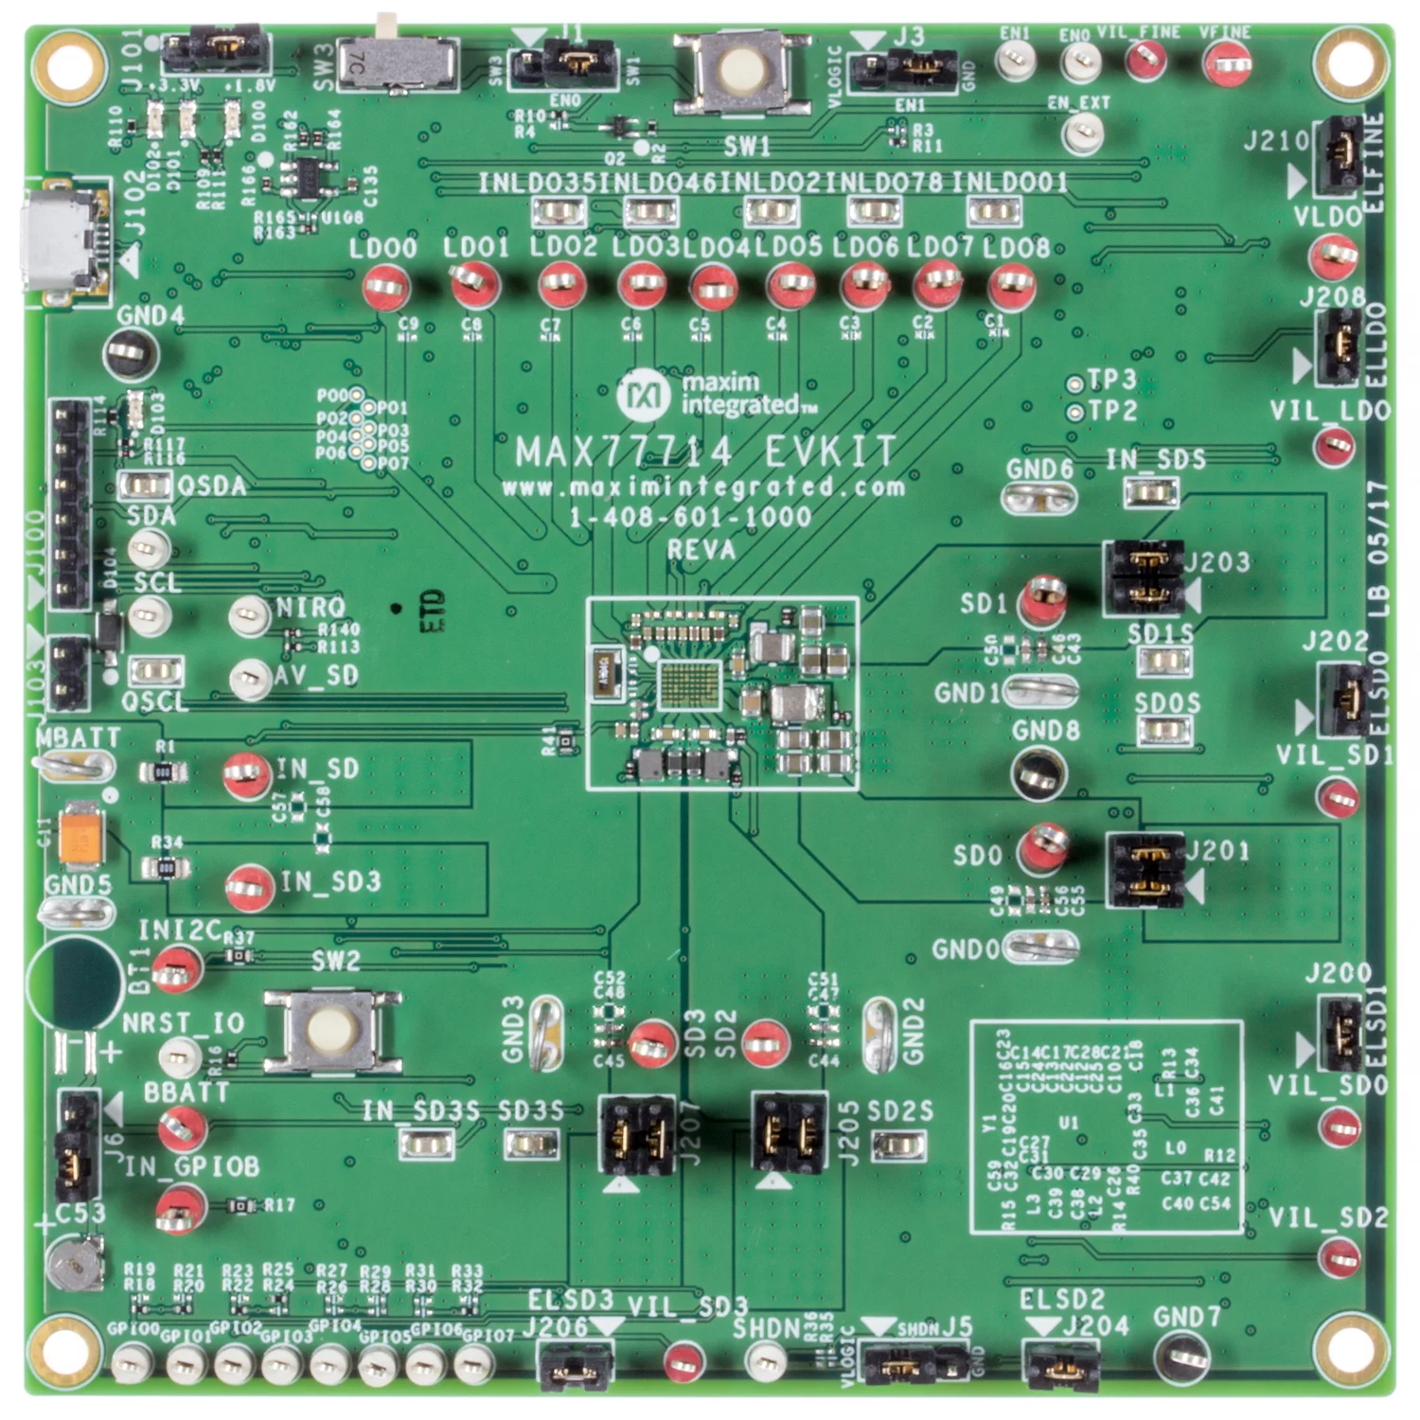

Modules we Need to Shield
Batteries (4)
Power management circuit (PMC)
Digital processing circuit (DPC)

Slide 5
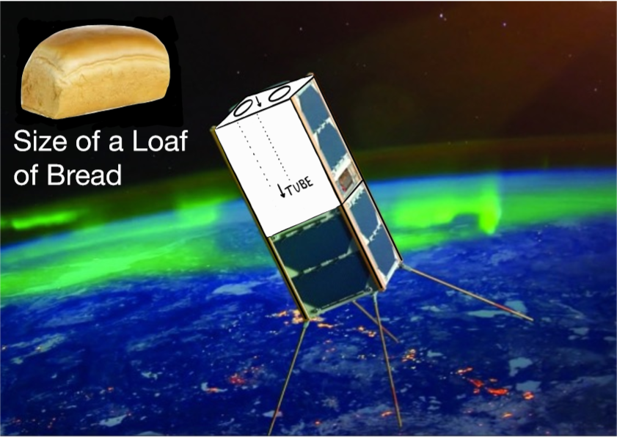
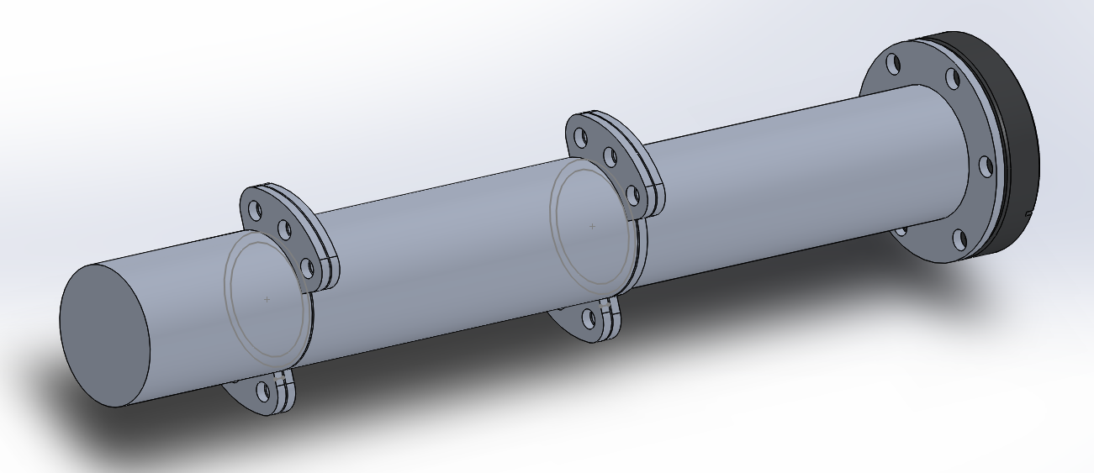
Shielding
Outer solar panels form a cube
Tube caddy for electronic components
Modular, open source design
Casing thickness is 3/16”

Slide 6
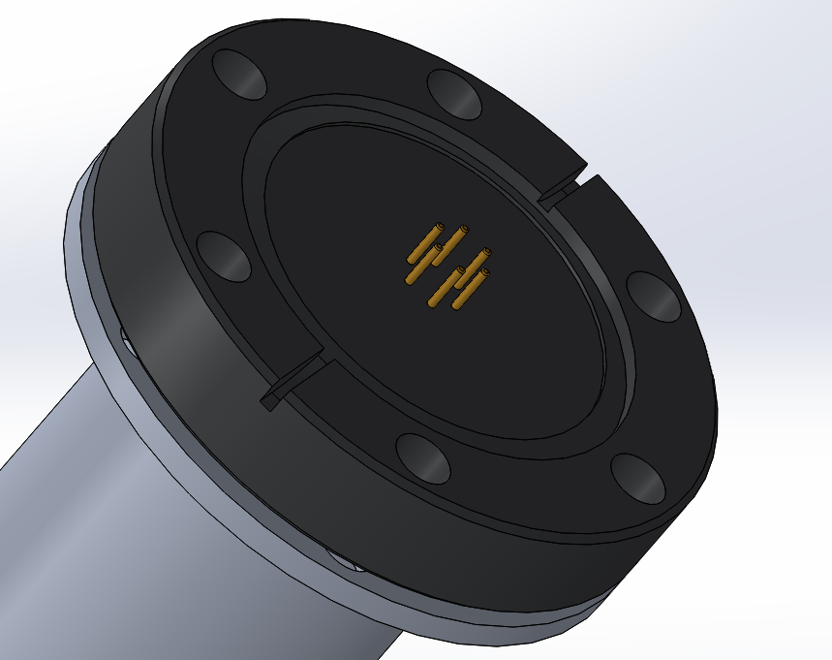
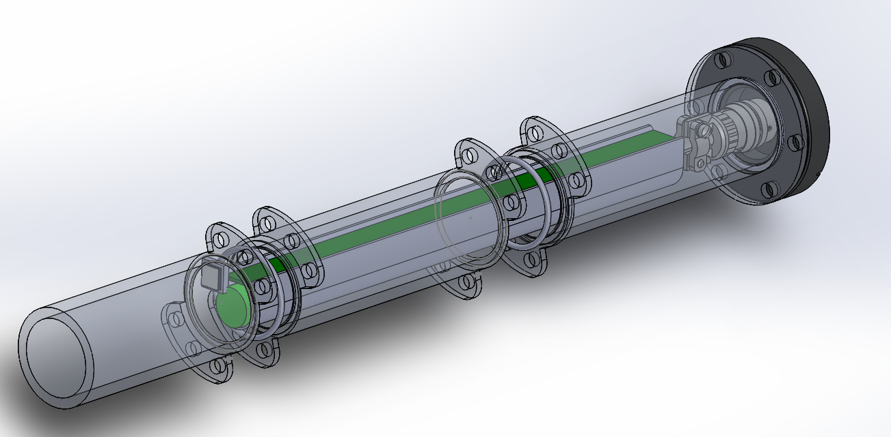
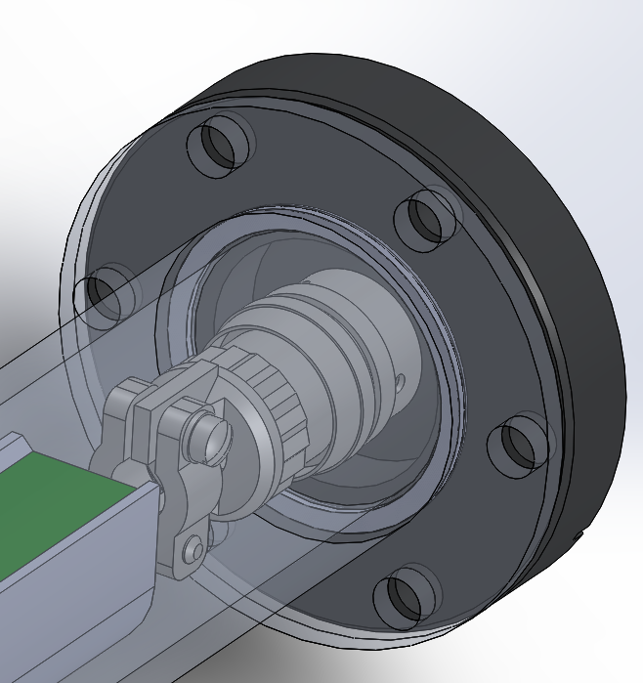
A More Detailed Look

Slide 7
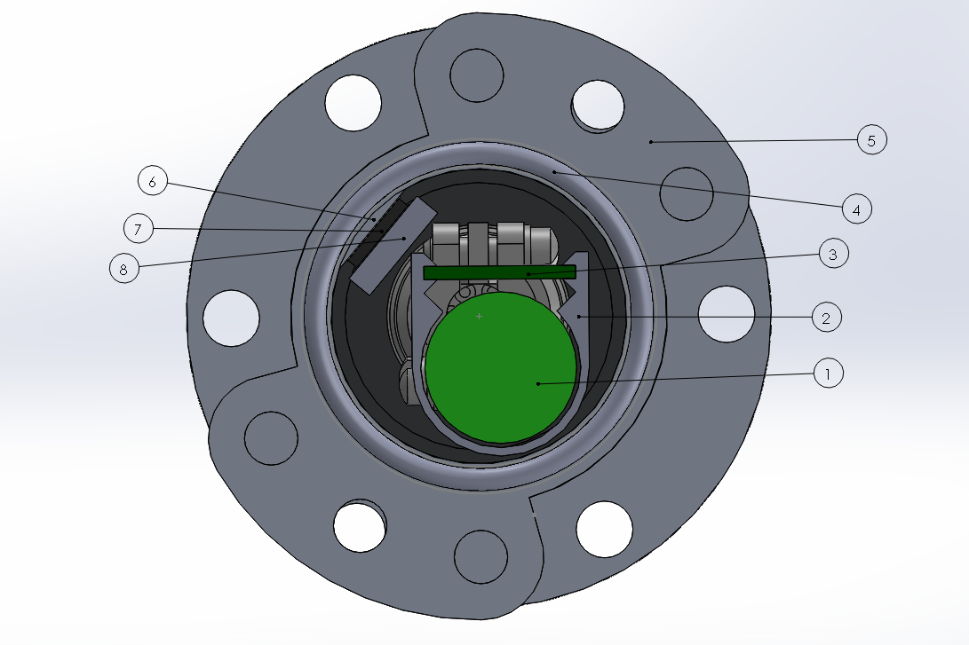
6 - Core Casing TEC Mount Surface
7 - TEC
8 - TEC/Caddy Thermal Coupling Block
1 - Battery Cells
2 - Caddy
3 - PCB
4 - O-Ring
5 - Coupling Flanges

Slide 8
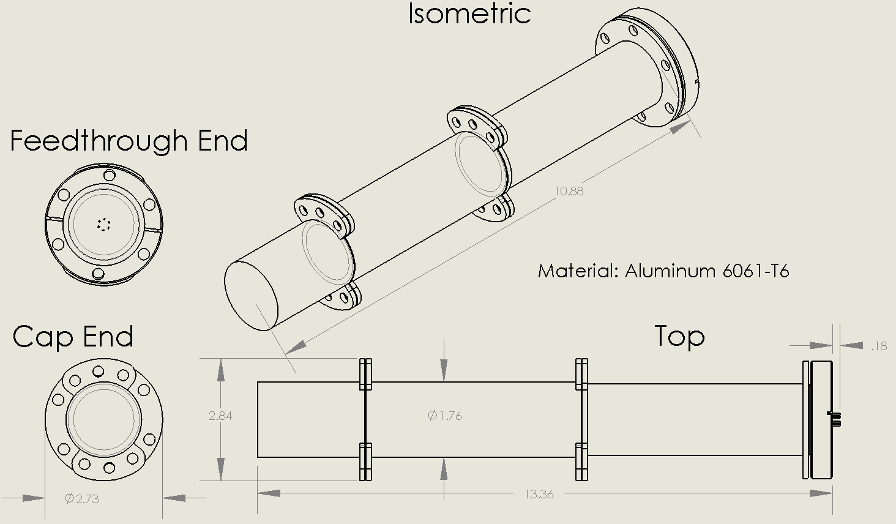
[ Dimensions are in inches ]

Slide 9
Preliminary Cost Estimates
Solar cells (10 cells = $35)
Aluminum Sheet 24” X 48” + Cut ($100)
3D Hub Core Case ($475)
Feed through end cap($250)
PCB ($200)
PCB Bill of Materials ($150)
Peltier ($75)
Caddy ($60)
CURRENT TOTAL - $1345

Slide 10
Physical Obstacles
Air leakage
Start with 1 atm (14.7 psi at sea level)
Leak rate for ‘very tight system’ such as ours found to be 1.45*10^-7 psi/s, or 2.286 psi/6 months
Goal to maintain 12 psi or more after 6 months
Temperature control
Implement a thermal coupler to control the temperature of the core casing

Slide 11
Power Consumption and Expenditure
10 x 2.5 Watt Solar Cells
Internal magnetic element gives attitude control
3 sides of sat facing sun = 5 exposed solar cells = Ideally 12.5 Watts
140.415 degrees of orbit in shade
7671.783 m/s orbital velocity @ 400 km altitude
36 minutes in shade (0 watts)
56 minutes in sunlight (Ideally 12.5 Watts)
Battery system capacity = 2200 mAh @ 16.8 V = Approx 37 Wh

Slide 12
Milestones
2/14 - Mechanical design complies with 12U standard
2/28 to 3/6 - PMC (Power Management Circuit) and DPC (Digital Processing Circuit)
Charge/discharge of batteries through solar cell operation
Proper cell balancing
Stable power transfer at 1C or 2200 mA
Verified DPC serial communication ability
TEC op-amp circuit functioning
Mapping of circuit to 18mm x 263mm 4-layer PCB strip
Addition of copper paths for thermal distribution
3/21 - Circuit board, battery system, thermal TEC, and caddy installed into core casing
4/10 - Outer Paneling Assembly & Operation of satellite fully assembled
PCB temperature does not exceed -100F to 75F during operation
Air leakage rates agree with calculated values
Notes:
PCB temperature does not exceed -100F to 75F
PMC and DPC operation under full temperature range
Core casing pressure holds

Slide 13
Questions?

